Slide 1
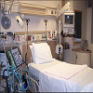

01
Iot based patient monitoring system
Submitted to-
Ahmed Imteaj
Lecturer
Dept of CSE,IIUC
Submitted by-
1.Mohammad Anas(C151107)

Slide 2
CONTEXT
02
Overview
What is Patient Monitoring?
Intensive Care Unit
Background Theory
What is IoT for health care ?
Proposed System
Necessary hardware and software requirement
Mathematical notation
Connection Diagram
WORKING
Introduction of Cloud
Software and Mobile Application
Application Working
FUTURE ENHANCEMENTS
Conclusion
Reference

Slide 3
Overview
03
The Internet of Things (IoT) is becoming increasingly important for traffic monitoring, smart homes, smart parking management and other industrial applications. With the continuous development of the IoT, more and more “things” will be able to access to the IoT. In this project, We have proposed an intelligent patients monitoring system to monitor the patient automatically with the help of IoT (more specifically connected sensors network) that collects the status information which include patient's heart rate, ECG, SPO2, body temperature, humidity, blood pressure, unexpected body movement etc. and sends these data to the cloud. As a result, patient's doctor and nurses can see his current health condition. In case of emergency if the patient's health condition is not stable (critical), the system automatically sends a push notification to doctors and nurses.
This would help the doctor to monitor his patient from anywhere as well as helps the patient's relatives to view his (patient) health condition remotely(with limited access).

Slide 4
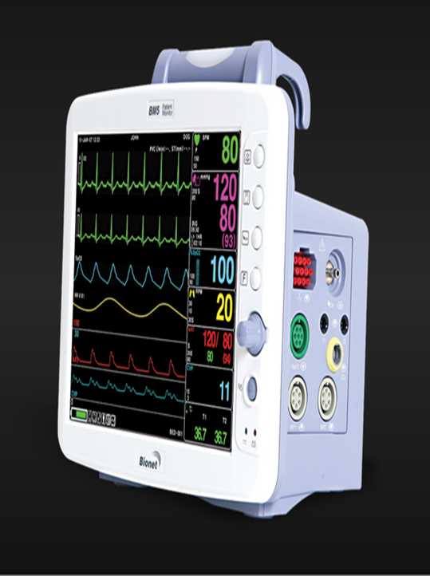
What is Patient Monitoring?
04
Continuous measurement of patient parameters such as heart rate and rhythm, respiratory rate, blood pressure, blood-oxygen saturation, and many other parameters have become a common feature of the care of critically ill patients. When accurate and immediate decision-making is crucial for effective patient care, electronic monitors frequently are used to collect and display physiological data. Increasingly, such data are collected using non-invasive sensors from less seriously ill patients in a hospital’s medical-surgical units, labor and delivery suites, nursing homes, or patients’ own homes to detect unexpected life-threatening conditions or to record routine but required data efficiently.
Fig: display

Slide 5
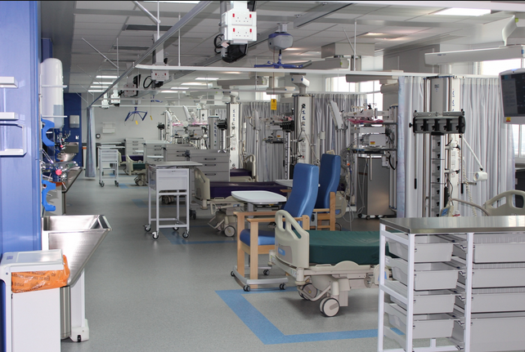
Intensive Care Unit
05
An intensive care unit (ICU), also known as an intensive therapy unit or intensive treatment unit (ITU) or critical care unit (CCU), is a special department of a hospital or health care facility that provides intensive treatment medicine. Intensive care units cater to patients with severe and life-threatening illnesses and injuries, which require constant, close monitoring and support from specialist equipment and medications in order to ensure normal body functions. They are staffed by highly trained doctors and nurses who specialize in caring for critically ill patients.
Patients may be transferred directly to an intensive care unit from an emergency department if required, or from a ward if they rapidly deteriorate, or immediately after surgery if the surgery is very invasive and the patient is at high risk of complications.
Fig: ICU

Slide 6
Background Theory
06
The Technology behind this project is IOT (Internet of Things).The above fig. shows basic block diagram shows working of Internet of Things based systems where hardware system contains sensor measure the respective parameters, controllers, required modules which further processed and upload the collected data to the cloud. In the second part, cloud service provider is selected which give us a service to store our data and access it over mobile application/website. In the third part, uploaded data is fetched on an android application which provides a friendly graphical user interphase help the person to access his/her monitored health data.

Slide 7
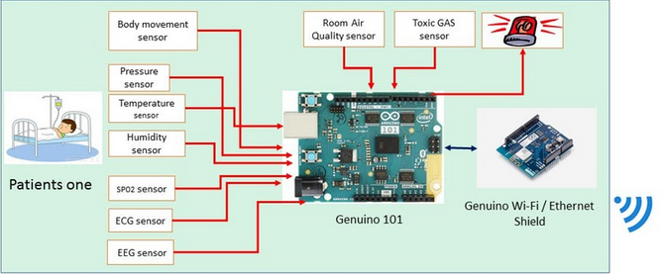
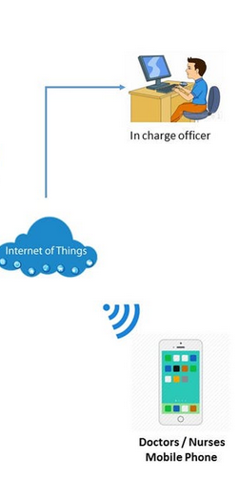

What is IoT for health care ?
07
Interconnected sensors extending information over WSN, WAN network to healthcare providers to improve human health and well being

Slide 8
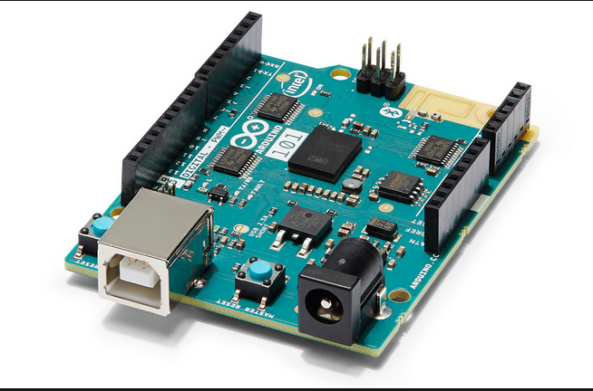
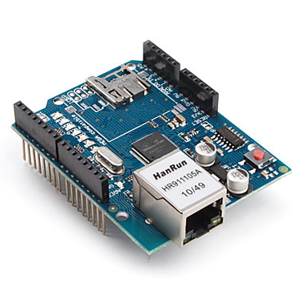
Proposed System
08
We use Genuino 101 (IoT Development Board) and Ethernet shield here.
Genuino 101 is used as a main controller of this system. All the others sensors are directly connected with it.
An Ethernet shield is used for connecting the board with the cloud. All the hardware components of this system are listed in (things section). The thinger.io IoT platform is used for real time data streaming and visualization.

Slide 9
Necessary hardware and software requirement
09
Hardware Specifications:
Power Supply
Rectifier
Regulator
LCD Display
Temperature and Humidity Sensor
Blood Pressure Sensor
Genuino 101
Ethernet shield
Resistors
Capacitors
Diodes
Software Specifications:
Arduino IDE
Android Studio

Slide 10
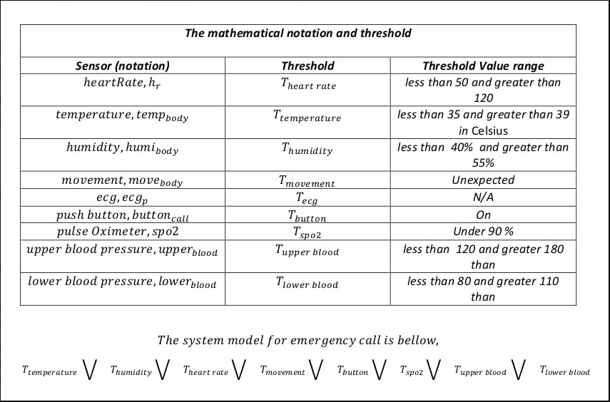
Mathematical notation of sensors and threshold level and the mathematical model for emergency call of this system:
10

Slide 11
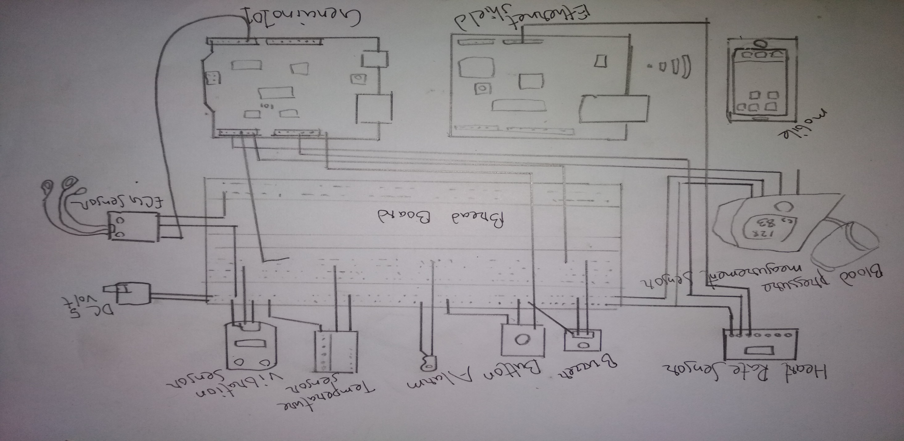
Connection Diagram
11

Slide 12
WORKING
12
In this, we have used Arduino mega as microcontroller unit. All the components and modules are connected as give in a circuit diagram.
For this system we required two types of power supply 5V or 3.3 V because of some components are operated in 3.3 V.All the sensors, which generates the analog output is connected to an analog pin of Arduino's analog pins. And Digital sensors like (Temp., Humidity) there are connected to digital pins. The Ethernet Shield (HANRUN) is used in this system for internet connectivity. It can be replaced by GSM or Wi-Fi module also.
The analog/digital data are processed by arduino and with the help of internet connectivity all the monitored data sended to the cloud (Here we have used Things Speak).Thing Speak cloud provides the MATLAB Visualization or MaATLAB Code. By this we can plot graph and getting desirable data.
We have also developed Android app for Visualization of data to others. All data from cloud are available into mobile application. This mobile app also generates alerts when required.

Slide 13
Introduction of Cloud:
13
Cloud computing:
Cloud computing, also known as on-the-line computing, is a kind of Internet-based computing that provides shared processing resources and data to computers and other devices on demand. It is a model for enabling ubiquitous, on-demand access to a shared pool of configurable computing resources (e.g., networks, servers, storage, applications and services), which can be rapidly provisioned and released with minimal management effort. Cloud computing and storage solutions provide users and enterprises with various capabilities to store and process their data in third-party data centers. It relies on sharing of resources to achieve coherence and economy of scale, similar to a utility (like the electricity grid) over a network.
Cloud storage:
Cloud storage is a model of data storage in which the digital data is stored in logical pools, the physical storage spans multiple servers (and often locations), and the physical environment is typically owned and managed by a hosting company. These cloud storage providers are responsible for keeping the data available and accessible, and the physical environment protected and running. People and organizations buy or lease storage capacity from the providers to store user, organization, or application data.
Thing Speak Channel:
Channels store all the data that a Thing Speak application collects. Each channel includes eight fields that can hold any type of data, plus three fields for location data and one for status data. Once we collect data in a channel, we can use Thing Speak apps to analyze and visualize it.

Slide 14
Channel Setting of Cloud
14
Channel Name: Enter a unique name for the Thing Speak channel.
Description: Enter a description of the Thing Speak channel.
Field#: Check the box to enable the field, and enter a field name. Each Thing Speak channel can have up to 8 fields.
Metadata: Enter information about channel data, including JSON, XML, or CSV data.
Tags: Enter keywords that identify the channel. Separate tags with commas.
Latitude: Specify the position of the sensor or thing that collects data in decimal degrees. For example, the latitude of the city of London is 51.5072.
Longitude: Specify the position of the sensor or thing that collects data in decimal degrees. For example, the longitude of the city of London is -0.1275.
Elevation: Specify the position of the sensor or thing that collects data in meters. For example, the elevation of the city of London is 35.052.
Make Public: If you want to make the channel publicly available, check this box.
URL: If you have a website that contains information about your Thing Speak channel, specify the URL.
Video ID: If you have a YouTube™ or Video® video that displays your channel information, specify the full path of the video URL.

Slide 15
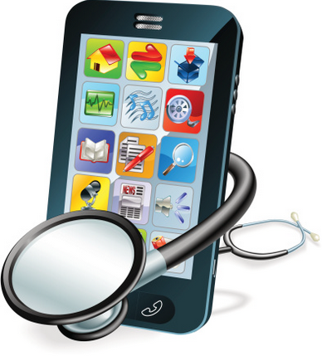
Software and Mobile Application
15
We will develop a Mobile application for doctors/nurses for monitoring the patient based on sensors data(the data contains current condition of the patient) in real time. In case of emergency, the system automatically notifies doctors/nurses through push notification provided that, the emergency condition is determined by the equation(slide no:10) . We will also develop another web based application for hospital in-charge personal for monitoring the patient constantly.

Slide 16
Application Working
16
· This application can be used by DOCTORS and PATIENTS:
Doctor
In the application, doctor can register themselves with their personal information of their clinic, address, field, etc. and consists of a unique doctor id through application after registration. It can check the status of their entire registered patient in the app. Status means the data of every single patient which is connected to that particular doctor. Each doctor can have multiple patients and every patient has their own unique patient id. This unique id will help doctor and patient to connect with them and doctor can track or check the record of every patient.
Patient
Patient will be provided with the unique id and password while registration of hardware device. Patient will able to see their al personal details and their all data of different fields in the app. This will consists of all historical data till the present date which can be filter according to their requirements. Patient can anytime view their health status data of different field anywhere anytime.

Slide 17
Login Credentials:
17
Doctor:
Doctor will require 2 credentials for login:
· Doctor Id
· Password Patient:
Patient will require 2 credentials for login:
· Patient Id
· Password

Slide 18
User Interface:
18
Doctor Interface:
When the doctor will successfully signed in to the app , it will direct to main activity which will consists of navigation drawer and the name of the patient in their main screen.
Patient Interface:
After successfully login of patient, it will direct to main screen which will consists of the personal information of a patient and ask for a selection of field to get the data of a particular field.

Slide 19
FUTURE ENHANCEMENTS
19
The applications can be added by adding the more modules and sensors.
Accuracy can be increased by using high sensitive sensors and more reliable modules.
For more security and functionality in the cloud can be increased by using paid clouds or won cloud.
Using the X-bee Module we can create a wireless zone and this device may communicate with the other devices also in big hospitals.
Ethernet Module can be replaced by Wi-Fi module and GSM module for Internet Connectivity.
For simpler GUI we can draw Sketches and Graphs in the Mobile applications.

Slide 20
Conclusion
20
The proposed system provides better solution over traditional methods. It increases the quality of service as well as the capacity of ICU unit. The application of this system is not limited to ICU unit, it may extend as a portable health monitoring device for older people (who lives alone) as well as monitoring babies and people having cardiovascular disease.

Slide 21
Reference
21
What is Intensive Care?, http://www.ics.ac.uk
What is an ICU, http://www.wisegeek.org
Intensive care unit, https://en.wikipedia.org
A. Whitmore, A. Agarwal, and L. Da Xu, The Internet of Things—A survey of topics and trends,Information Systems Frontiers, vol. 17, pp. 261-274 (2015)
S. Li, L. D. Xu, and S. Zhao, The internet of things: a survey,Information Systems Frontiers, vol. 17, pp. 243-259 (2015)

Slide 22
??

Slide 23
THANK YOU

